Slide 1
Ingenious Mavericks
Academic Social Portal

Slide 2
Description
An academic portal which allows students to get information on the classes and the professors without being influenced by personal opinions. The aim of this portal is the provide a solution that prevents scenarios where students are confused about classes or face issues like class timing clashes or not having classes to take up. It also aims at providing a platform where students can discuss about swapping classes and answer questions asked about classes , professors or another academic and university related information.

Slide 3
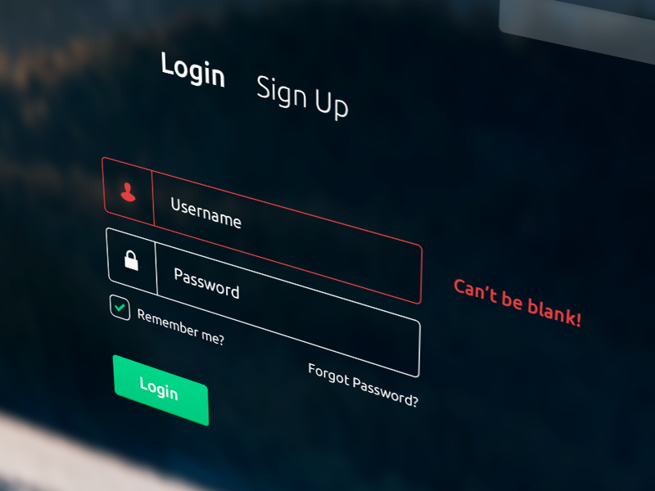
Webpage Entry Point
Login & Sign-Up Pages

Slide 4
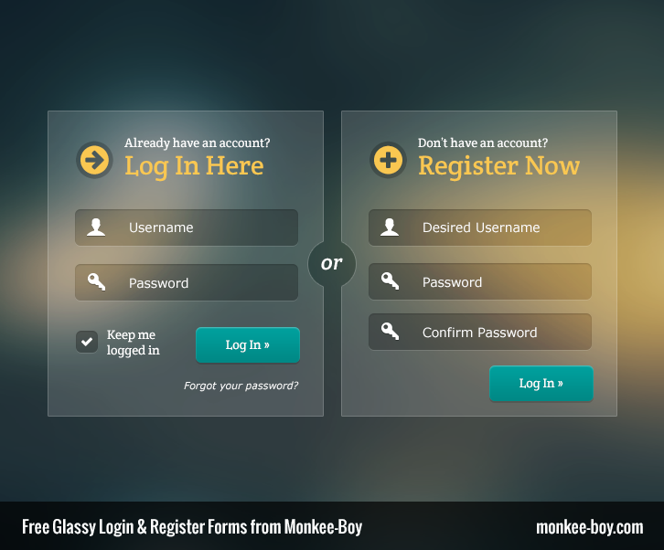
Security Points considered for Sign – Up
1.Only University email id allowed.
2. Common password constraints .
Information Collected for Sign- Up( Students)
1. Name
2.Department
3. Career
4.Year of Graduation

Slide 5
Tentative Subpages in the website
1. Rating Page/Reviews( professor-subject / professor)
2. Add Rate/Drop Rate of classes.
3. Swap Forum

Slide 6
1. Rating Page/Reviews( professor-subject / professor)
Fields Required:
Rating
Reviews
Class
Professor
Term

Slide 7
2. Add Rate/Drop Rate of classes.
Fields Required:
Class
Professor
Term
Add Rate
Drop Rate

Slide 8
3. Swap Forum

